Slide 1
DESIGN AND PERFORMANCE ANALYSIS OF HYBRID SKLANSKY ADDER

Slide 2
OBJECTIVE:
The objective of this work to design a hybrid adder by modifying Sklansky adder using the few stages of Brent Kung adder to reduce the power and delay.

Slide 3
INTRODUCTION
Adder is the basic building block in all digital circuits and processors.
In general, adders are constructed using half adder and full adder
For small number of bits, ripple carry adder, carry skip adder, carry select adder, increment adder, carry save adder, carry bypass adder can be used. But the delay and area are increased in this adder.
For more number of bits Kogge Stone adder, Brent Kung adder, Ladner Fischer adder, Sklansky adder are preferable to reduce the delay and area.

Slide 4
LITERATURE SURVEY
1. “High-Speed Area-Efficient VLSI Architecture of Three-Operand Binary Adder”
IEEE TRANSACTIONS ON CIRCUITS AND SYSTEMS–I: REGULAR PAPERS (2020)
Carry save adder is the widely used technique to perform the three-operand addition. However, the ripple-carry stage in the carry save adder leads to a high propagation delay of O(n). Moreover, a parallel prefix two-operand adder such as Han-Carlson (HCA) can also be used for three-operand addition that significantly reduces the critical path delay at the cost of additional hardware. The proposed three-operand adder technique is a parallel prefix adder that uses four-stage structures to compute the addition of three input operands. The novelty of this proposed architecture is the reduction of delay and area in the prefix computation stages in PG logic and bit-addition logic that leads to an overall reduction in critical path delay, area-delay product (ADP) and power-delay product (PDP).

Slide 5
Contd,….
2. “Variable Latency Speculative Han-Carlson Adder”
IEEE TRANSACTIONS ON CIRCUITS AND SYSTEMS—I: REGULAR PAPERS (2015)
In speculative adders the sum and carry generation part is separated to reduce the area overhead. This paper proposes a novel variable latency speculative adder based on Han-Carlson parallel-prefix topology that resulted more effective than variable latency Kogge-Stone topology. The paper describes the stages in which variable latency speculative prefix adders can be subdivided and presents a novel error detection network that reduces error probability compared to previous approaches. Compared with traditional, non-speculative, adders, our analysis demonstrates that variable latency Han-Carlson adders show sensible improvements when the highest speed is required.

Slide 6
Contd,….
3. “Area–Delay–Power Efficient Carry-Select Adder”
IEEE TRANSACTIONS ON CIRCUITS AND SYSTEMS—II: EXPRESS BRIEFS, VOL. 61, NO. 6, JUNE 2014.
In the proposed scheme, the carry select (CS) operation is scheduled before the calculation of final-sum, which is different from the conventional approach. In conventional carry select adder (CSLA) and binary to excess-1 converter (BEC)-based CSLA have some problem the data dependence and identify redundant logic operations. Use this proposed method to eliminated all the redundant logic operations. The proposed CSLA design involves significantly less area and delay.

Slide 7
Contd,….
4.” Low-Power and Fast Full Adder by Exploring New XOR and XNOR Gates” IEEE TRANSACTIONS ON VERY LARGE SCALE INTEGRATION (VLSI) SYSTEMS (2018)
The proposed circuits are highly optimized in terms of the power consumption and delay, which are due to low output capacitance and low short-circuit power dissipation. We also propose six new hybrid 1-bit full-adder (FA) circuits based on the novel full-swing XOR–XNOR or XOR/XNOR gates. Each of the proposed circuits has its own merits in terms of speed, power consumption, powerdelay product (PDP), driving ability, and so on.

Slide 8
Contd,…
5. “ Design and Implementation of Hybrid Parallel Prefix Adder”
International Journal of Emerging Engineering Research and Technology Volume 3, Issue 8, August 2015, PP 117-124 ISSN 2349-4395 (Print) & ISSN 2349-4409 (Online)
In this paper combine Brent Kung adder and Kogge Stone adder for achieve better performance. Kogge stone adder having four levels and 49 cells and Brent Kung adder having six levels and 29 cells in our proposed hybrid adder five levels and 32 cells in first level same as Brent Kung adder. Second, third, four levels are same as Kogge Stone adder and finally fifth level belongs to brent kung adder then final output giving to final computing operation.

Slide 9
PROBLEM STATEMENT
Normal Sklansky adder occupies more area and have high fan out problem. The proposed new Hybrid Sklansky adder should aim to reduce area and power consumption by having less number of full adder.

Slide 10
PROPOSED SYSTEM
Parallel prefix adder [PPA] perform parallel addition.
PPA carries out three necessary steps:
Computation of carry generation and carry propagation signals by number of input bits (pre-processing).
Calculating all the carry signals in parallel that is called prefix computation (Carry graph).
Evaluating total sum of given inputs(Post processing).

Slide 11
Contd,….
1. Calculation of propagate and generate signals:
G_{i} = A_{i} ⋅B_{i} ....................(1)
P_{i} = A_{i}⊕B_{i} ....................(2)
2. Calculation of carry signals:
G_{i:j} = G_{i:k}+P_{i:k}⋅G_{k-1:j} ..............(3)
P_{i:j} = P_{i:k} ⋅ P_{k-1:j} ..............(4)
3. Calculation of final sum:
S_{i} = P_{i} ⊕ G_{i-1} ...................(5)

Slide 12
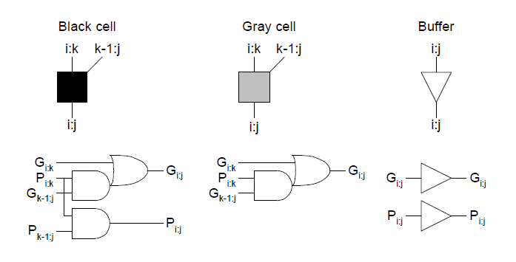
BLACK CELL, GREY CELL AND BUFFER

Slide 13
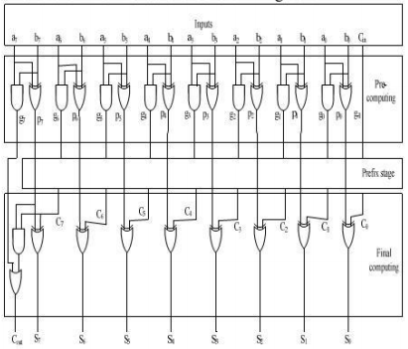
GENERAL BLOCK DIAGRAM OF PRALLEL PREFIX ADDER

Slide 14
CARRY LOOKAHEAD ADDER
The carry look ahead adder using the concept of propagating and generating the carry bit. It calculates one or more carry bits before the sum, which reduces the wait time to calculate the result of the larger value bits.
The expression for Carry propagate,Pi = Ai xor Bi
Carry generate, Gi = Ai . Bi
Sum expression, Si = Pi xor Ci
Carry out, Ci+1 = Gi + Pi Ci

Slide 15
SKLANSKY ADDER
The fan-out of the Sklansky adder increases significantly from the inputs to outputs along the critical path, which accounts for large amount of latency. This degrades the performance of the structure when the number of bits of the adder becomes large.
Sklansky adder is also called as divide-and-conquer tree.

Slide 16
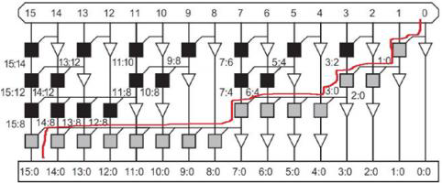
16-BIT SKLANSKY ADDER

Slide 17
BRENTKUNG ADDER
The Brent–Kung adder is a parallel prefix adder (PPA) form of carry look ahead adder (CLA). It introduced higher regularity to the adder structure and has less wiring congestion leading to better performance and less necessary chip area to implement compared to the Kogge Stone adder (KSA).
In Ripple Carry adder the time taken for addition was directly proportional to the length of the bit being added. This is reverse in Brent–Kung adders where the carry is calculated in parallel thus reducing the addition time drastically.

Slide 18
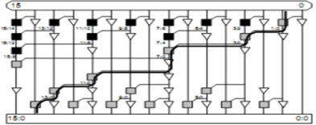
16-BIT RENT KUNG ADDER

Slide 19
PROPOSED HYBRID ADDER
Design a hybrid adder by modifying Sklansky adder with Brent Kung adder. the Sklansky adder has more number of black cells, instead of black cells replaced with grey cells so the gate count can be reduced, the modification done in gate level to improve the memory and delay.
Sklansky adder having four levels and 32 cells and Brent Kung adder having six levels and 29 cells in our proposed hybrid adder seven levels and 30 cells in first level and second level same as sklansky adder. third, and remaining level are same as Brent Kung adder and then final output giving to final computing operation.
Black cells indicates full adder and grey cells indicates half adder

Slide 20
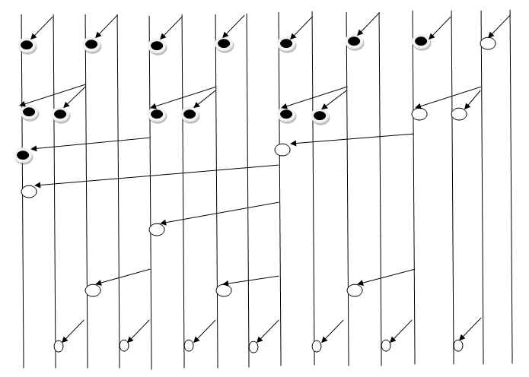
BLOCK DIAGRAM OF MODIFIED ADDER

Slide 21
WORK FLOW
STAGE 1: To design a hybrid adder.
STAGE 2: Compare the adder performance with other fast adder.

Slide 22
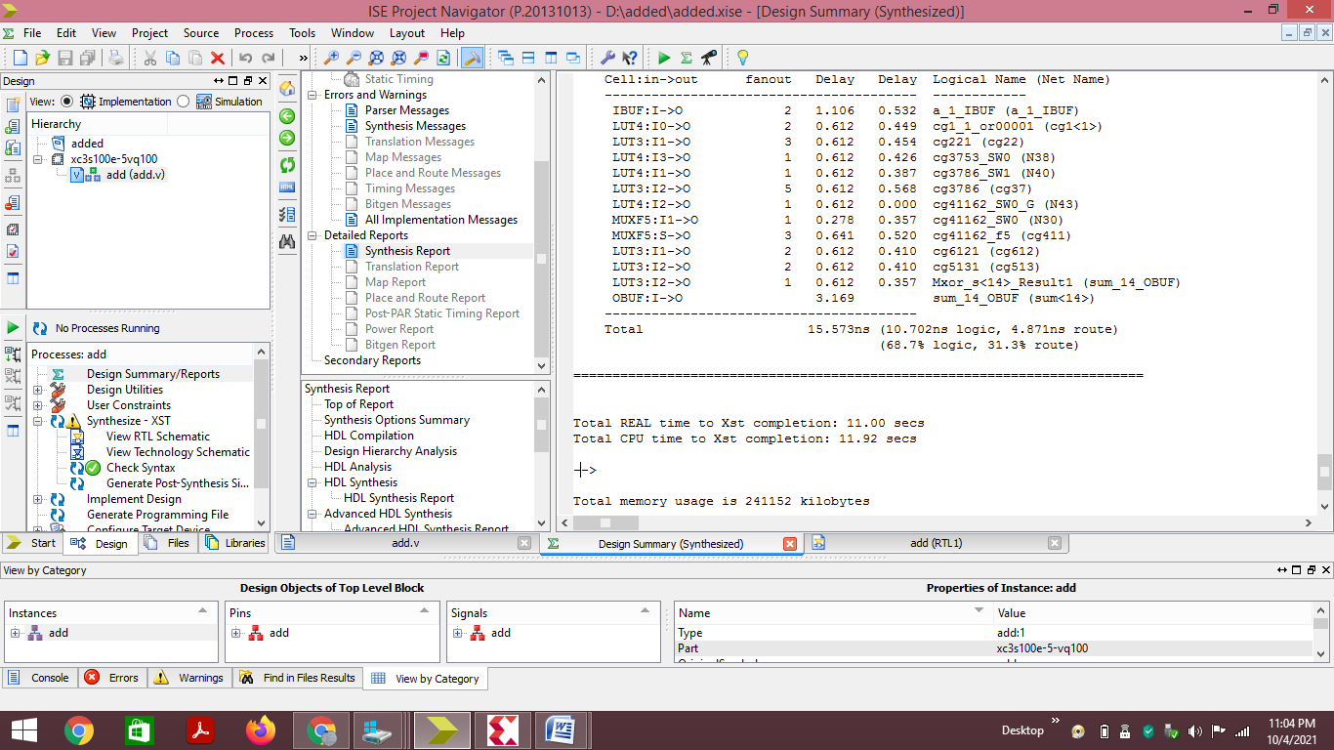
OUTPUT OF16-BIT BRENT KUNG ADDER (DELAY REPORT)

Slide 23
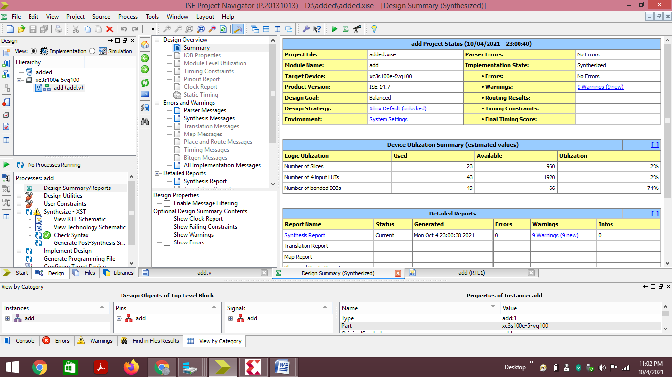
OUTPUT OF16-BIT BRENT KUNG ADDER (SUMMARY REPORT)

Slide 24
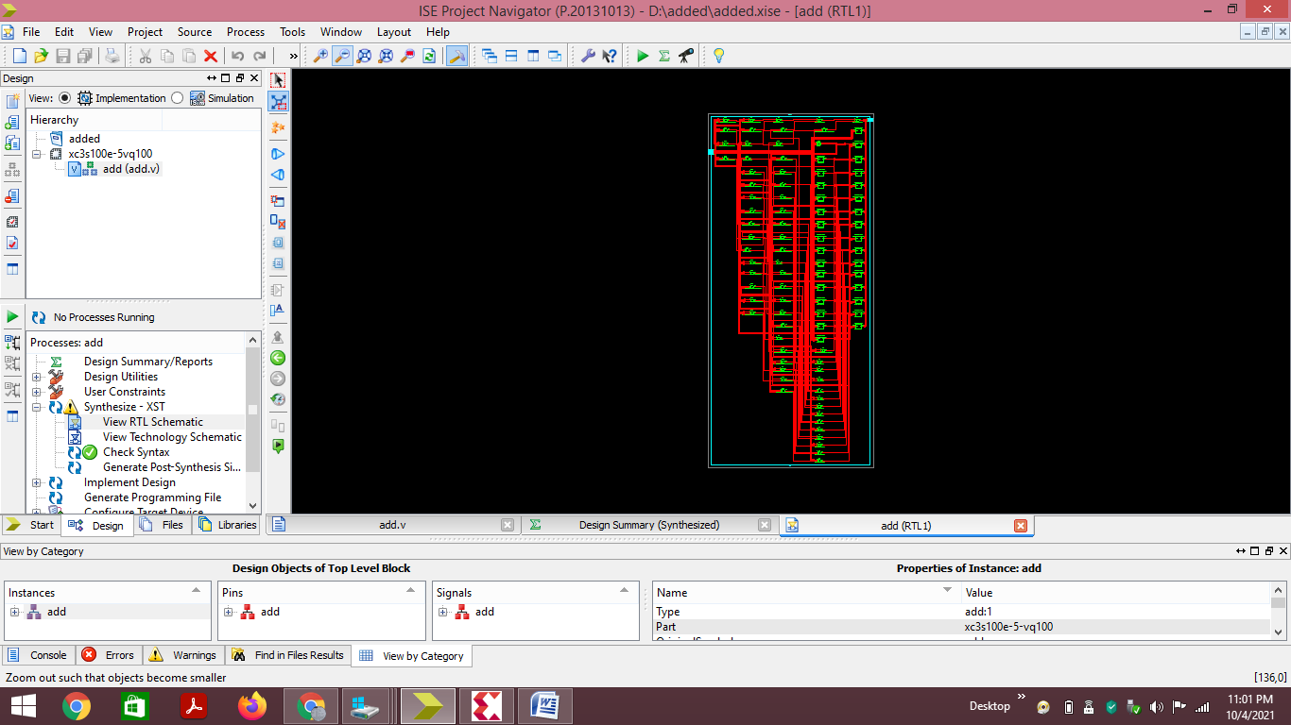
OUTPUT OF16-BIT BRENT KUNG ADDER (RTL VIEW)

Slide 25
References
M. Weber, M. Putic, H. Zhang, J. Lach, and J. Huang, “Balancing adder for error tolerant applications,” in Proc. IEEE Int. Symp. Circuits Syst. (ISCAS), May 2013, pp. 3038–3041.
Darjn Esposito, Davide De Caro, Senior Member, IEEE, and Antonio Giuseppe Maria Strollo, Senior Member, IEEE “Variable Latency Speculative Parallel Prefix Adders for Unsigned and Signed Operands” IEEE TRANSACTIONS ON CIRCUITS AND SYSTEMS—I: REGULAR PAPERS 1
Vincent Camus , Student Member, IEEE, Mattia Cacciotti , Student Member, IEEE, Jeremy Schlachter , Student Member, IEEE, and Christian Enz , Senior Member, IEEE“DESIGN OF APPROXIMATE CIRCUITS BY FABRICATION OF FALSE TIMING PATHS: THE CARRY CUT-BACK ADDER” IEEE JOURNAL ON EMERGING AND SELECTED TOPICS IN CIRCUITS AND SYSTEMS, VOL. 8, NO. 4, DECEMBER 2018

Slide 26
Pamishetti Sujith Kumar, Dr. D Subba Rao “Design and Implementation of Hybrid Parallel Prefix Adder “International Journal of Emerging Engineering Research and Technology Volume 3, Issue 8, August 2015, PP 117-124 ISSN 2349-4395 (Print) & ISSN 2349-4409 (Online)
Basant Kumar Mohanty, Senior Member, IEEE, and Sujit Kumar Patel “Area–Delay–Power Efficient Carry-Select Adder” IEEE TRANSACTIONS ON CIRCUITS AND SYSTEMS—II: EXPRESS BRIEFS, VOL. 61, NO. 6, JUNE 2014
Amit Kumar Panda , Member, IEEE, Rakesh Palisetty , and Kailash Chandra Ray , Member, IEEE “High-Speed Area-Efficient VLSI Architecture of Three-Operand Binary Adder” IEEE TRANSACTIONS ON CIRCUITS AND SYSTEMS–I: REGULAR PAPERS 1 (2020)

Slide 27
B.Gopinath, N.Sangeetha, S.Jenifer nancy and T.Umarani “Design and Implementation of High Speed Carry Select Adder” International Journal of Engineering Research & Technology (IJERT)ISSN: 2278-0181 IJERTV4IS020383 www.ijert.org(This work is licensed under a Creative Commons Attribution 4.0 International License.) Vol. 4 Issu 02, February-2015 419
Hamed Naseri and Somayeh Timarchi , Member, IEEE “Low-Power and Fast Full Adder by Exploring New XOR and XNOR Gates” IEEE TRANSACTIONS ON VERY LARGE SCALE INTEGRATION (VLSI) SYSTEMS

Slide 28
THANK YOU

